Slide 1
Using SharePoint search to develop custom solutions
Mirjam van Olst

Slide 2
About Mirjam van Olst
Microsoft Certified Master SharePoint 2007
MVP SharePoint Server
SharePoint Architect at Macaw
Co-organizing DIWUG and SDN
Blog: http://sharepointchick.com
Email: mirjam@macaw.nl
Twitter: @mirjamvanolst

Slide 3
Agenda
Improvements in SharePoint 2010 Search
Customize Search using the UI
Extend OOB Search Web Parts
Creating custom Search Solutions
Using PowerShell for SharePoint Search

Slide 4
Improvements in
SharePoint 2010 Search

Slide 5
Enterprise Search from Microsoft in 2010
Quick, easy, powerful search (free)
Complete intranet search
High-end search delivered through SharePoint
Family Values
Common UI Framework
Social search features and integration
SharePoint platform integration
End user and site administrator enablement
Common Connector Framework (BDC)
APIs and developer experience
Admin & deployment capabilities
Operations advantages (SCOM, scripting)

Slide 6
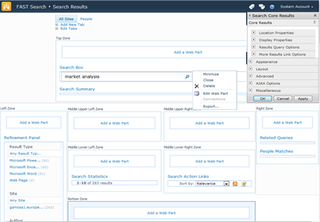
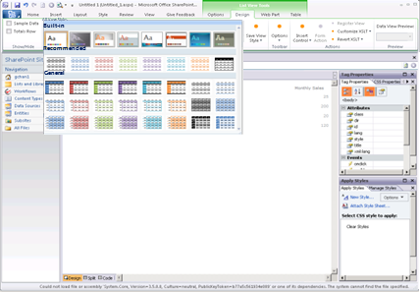
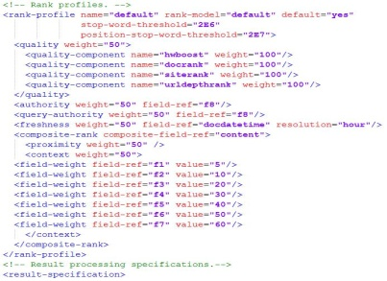
Do More with Search
Configure
Extend
Create
Solutions that previously required code
Enhancements made more rapidly with unified APIs
Bold, search-driven applications

Slide 7
Search Technology Concepts
Concepts
Search Center - UI for users to issue queries and interact with results
Query Object Model
OpenSearch Source
Query Servers - Accept query requests from users and return results
Query Servers
Query Federation - Return results from non-SharePoint Indexes
Index Partition
Indexing - Extract information from items to enable efficient matching
Indexer
Index Partition - Subset of the overall index
Crawling - Traverse URL space to record items in search catalog
Scaling
Crawler
Connectors - Know how to process different content sources
Content Sources - Host the content we want to return in main results
Content
Content
Content

Slide 8
SharePoint 2010 Search From an IT Pro’s perspective
Enterprise Scale-out (to 100M docs)
Consolidated search dashboard
PowerShell support
SCOM support
Full search reporting
Full set of connectors OOB
Easy to add new sources via BDC

Slide 9
SharePoint 2010 Search From a developer’s perspective
Public web parts
New connector framework
Integrated with Business Connectivity Services (BCS)
Integrate search with BI, Workflow, Social, & Collab
Application tooling in VS2010

Slide 10
Customise the Search UI

Slide 11
Customise Search using the UI
Edit the pages in the search center
Add your own scopes and tabs
Scopes can be based on
Web Address (http://portal.sharepoint.com/sites/evolution)
Managed Property (author=mirjam)
Content Source

Slide 12
Customise Search using the UI
Customise results to highlight metadata that matters
Change web part properties – no (C#) code
Modify XSLT
Modify config XML
Refinement panel – control metadata available for refinement
Advanced search – control metadata available for advanced search queries

Slide 13
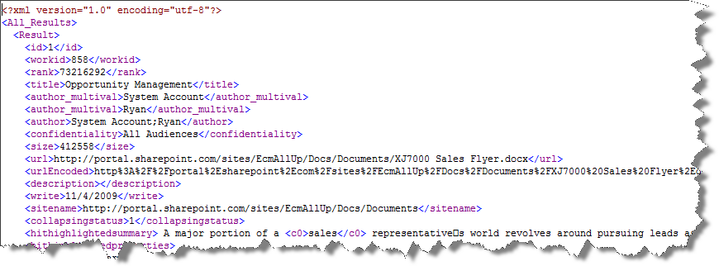
Get raw search results XML

Slide 14
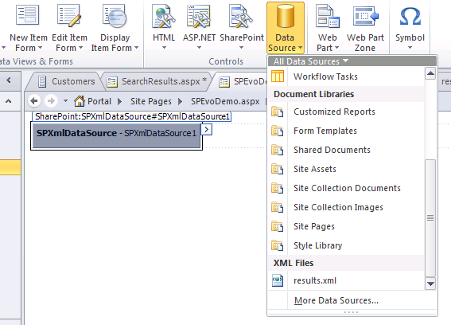
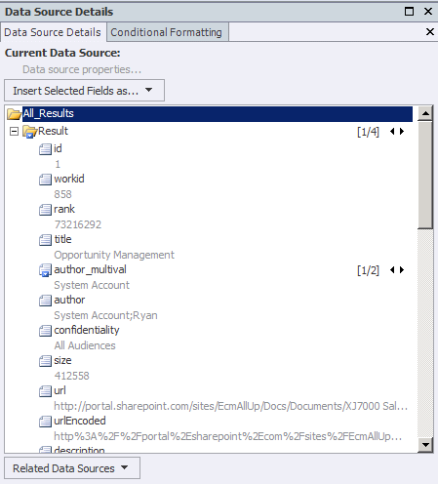
Add XML as datasource

Slide 15
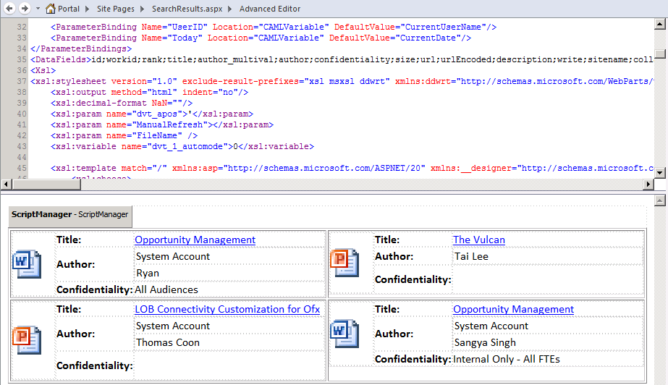
Adjust results in SPD

Slide 16
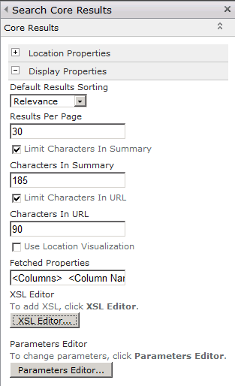
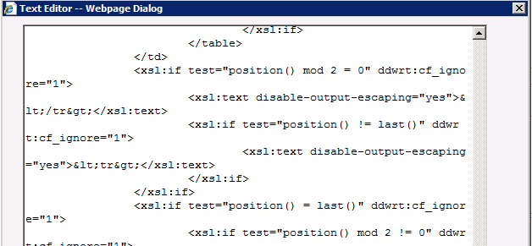
Copy SPD XSLT to Web Part
<xsl:stylesheet>
….
</xsl:stylesheet>

Slide 17
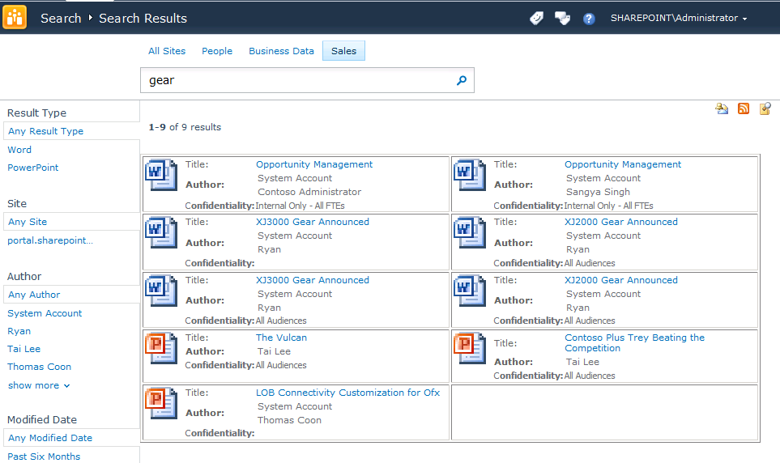

Slide 18
Extend OOB Web Parts

Slide 19
All web parts are public But some web parts are more public than others
Web Part | MOSS 2007 | SP2010 Beta 2
AdvancedSearchBox | Sealed | Sealed
CoreResultsWebPart | Unsealed | Unsealed
FederatedResultsWebPart | Unsealed | Unsealed
HighConfidenceWebPart | Sealed | Sealed
PeopleCoreResultsWebPart | Sealed | Sealed
PeopleRefinementWebPart |  | Unsealed
QuerySuggestionsWebPart |  | Unsealed
RefinementWebPart |  | Unsealed
SearchPagingWebPart | Sealed | Sealed
SearchStatsWebPart | Sealed | Sealed
SearchSummaryWebPart | Sealed | Sealed
TopFederatedResultsWebPart | Unsealed | Unsealed

Slide 20
SharedQueryManager class
All search web parts use SharedQueryManager class
One shared instance of the SharedQueryManager per search page
At least one search results web part needs to be on the page
Use SharedQueryManager to access other classes of the Federation Object Model
SharedQueryManager.GetInstance(this.Page).QueryManager

Slide 21
Federation Object Model
New object model in SharePoint 2010
Provides a unified interface to search against different locations/engines
Allows for combining and merging of results
Supports 3 locations out-of-box
SharePoint Search
FAST Search
OpenSearch

Slide 22
Federation Object Model (OM)
Using the Federation OM you can
Hook into the query path; you can e.g. fetch the search results after the query has been executed
Modify the query before submitting it to the search backend e.g. add query terms before request is submitted

Slide 23
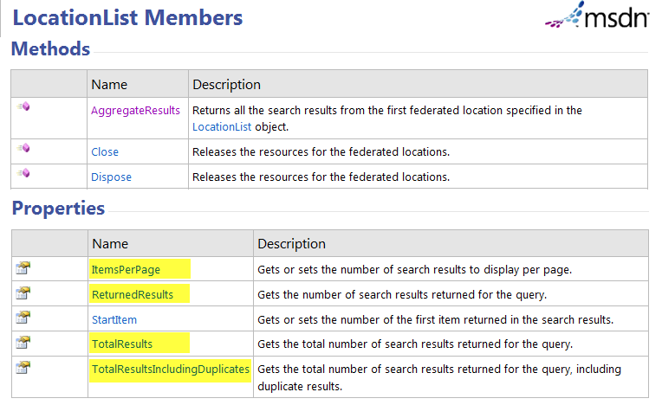

Slide 24
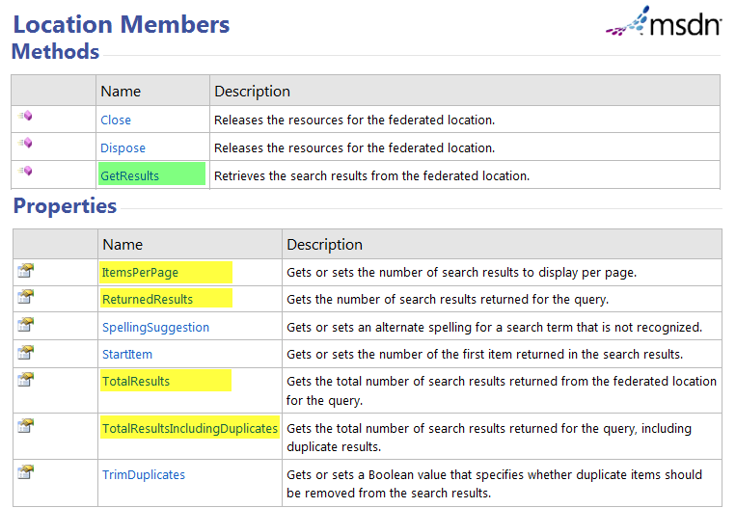

Slide 25
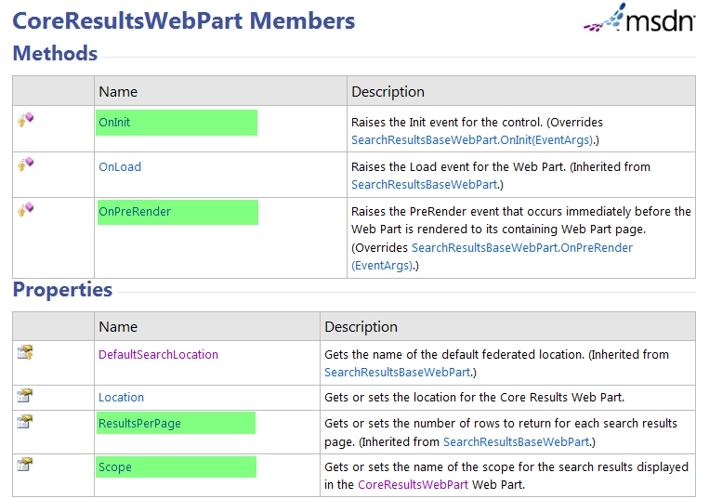

Slide 26
Connector Framework
Use OOB Connectors (Database/WCF/.NET)
Create/Deploy model using SPD and use Search UI to configure crawls
Create/Deploy entities and methods using VS.NET and use search UI to configure crawls
New features
Support for attachments
Item level security
Crawl through entity associations
Inline caching for better citizenship
Richer crawl options
Notes:
For new features we now fully support attachments with BCS; in SharePoint 2007 if we tried indexing a database and it had a blob we wouldn’t index the blob. We now also support item level security in two ways. If you are connecting to a web service we have a GetSecurityDescriptor method in BCS that we will call to get security the security descriptor of the item we’re crawling. If it’s a database and you have the ACL stored in a column, you can specify the column that we should look at to capture the ACL info. We also crawl through entity associations, which means that we will try and maintain a foreign key relationship. In SharePoint 2007 we would crawl through them as two separate entities but never know anything about the foreign key relationship.
For caching and batching, we now request data in very big payloads from BCS. When we need a subsequent piece of data we now look first in the cache to retrieve it, rather than hitting the BCS target each and every time.
For crawling we have the same full crawl like with did in SharePoint 2007. We also have a new time stamp based incremental crawl. To use it you specify in the BCS model which field contains the time stamp that we should use to look at when it was last updated.
Both of the change log crawls are new for BCS in SharePoint 2010. We use the change log crawl + delete with Exchange, because Exchange keeps its own change log so it can tell us what has changed and what has been deleted since the last crawl.

Slide 27
Extend Out-OF-THE-BOX Search Web Parts
DEMO

Slide 28
Creating custom Search
Solutions

Slide 29
Integration points outside of farm
Query Web Service
SOAP based ASMX service
Uses same schema for FAST Search and SharePoint Search
Provides search results, query suggestions, meta data and more
Query RSS
Lightweight integration point

Slide 30
Administration Object Model
Can be used for managing Search in your farm
Represents Central Admin functions
Use it to get SearchServiceApplicationProxy

Slide 31
Query Object Model
Communicates with the Search Service Application for getting search results
Be aware, use the SharePoint Server object model, not the SharePoint Foundation one
Microsoft.Office.Server.Search.Query NOT Microsoft.SharePoint.Search.Query

Slide 32
KeywordQuery
Part of Microsoft.Office.Server.Search.Query
Use Case
End User
Basic filtering
Simple and easy to use
Avoids parsing and construction of SQL
Filter by any string or integer property

Slide 33
Keyword Syntax
Support for Boolean operators
(“Taxi” OR “Train”) AND (Author:”John Cleese”)
Prefix matching for keywords and properties
Micro* title:SharePoint*
Improved operator support
= > >= < <=
Scopes
scope:”business data”

Slide 34
FullTextSqlQuery
Part of Microsoft.Office.Server.Search.Query
Use Case
Advanced search solutions
Complex queries
Similar to SQL queries, but not the same
Limited set of query terms can be used
Some fields need double quotes around them
Difficult to debug and troubleshoot

Slide 35
SharePoint SQL Syntax
SELECT
FROM SCOPE()
WHERE
AND, OR, NOT
CONTAINS()
FREETEXT()
LIKE
DATEADD(DAY, #, GETGMTDATE())
ORDER BY ASC | DESC

Slide 36
SharePoint SQL Syntax
SELECT “DAV:Href”, “Title”,
“Description”
FROM SCOPE()
WHERE FREETEXT(‘gallery hinges’)
AND “SITE” = “http://support”
AND “SCOPE” = “Products”
AND NOT CONTAINS(‘brass’)

Slide 37
Process Results
'ResultsTableCollection': IDataReaders
One table for each requested result type
RelevantResults
SpecialTermResults
RefinementResults
VisualBestBetsResults
HighConfidenceResults
DefinitionResults
Tip: use LINQ to work with results

Slide 38
Use SharePOint search to create custom solutions
DEMO

Slide 39
Using PowerShell for
SharePoint Search

Slide 40
Manageability - PowerShell
118 SharePoint Search cmdlets!
Verbs, nouns, objects , pipes, and scripts
Get-SPEnterpriseSearchServiceApplication | Set-SPEnterpriseSearchServiceApplication
Unlock advanced configurations
SSA VerboseQueryMonitoring
Import-SPEnterpriseSearchTopology
Export-SPEnterpriseSearchTopology

Slide 41
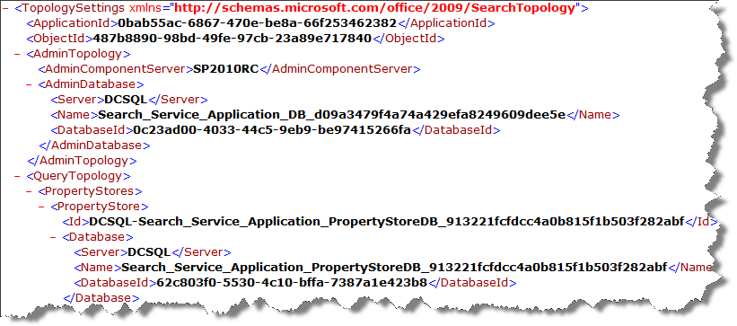
Export Search Topology

Slide 42
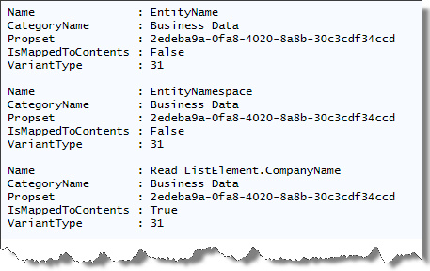
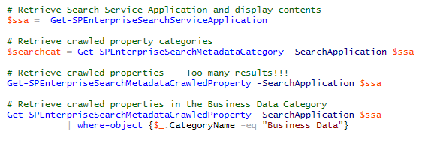
Example – Crawled Properties

Slide 43
Summary
Highly customisable search UI
Public web parts and SharedQueryManager
New Connector framework
FullTextSqlQuery for writing your own complex search queries
LINQ for managing result sets
PowerShell for configuring and managing search

Slide 44
Vragen?

